Slide 1

CSE3251
Computer Networks
Dr. Asif Zaman
Professor, CSE, RU

Slide 2
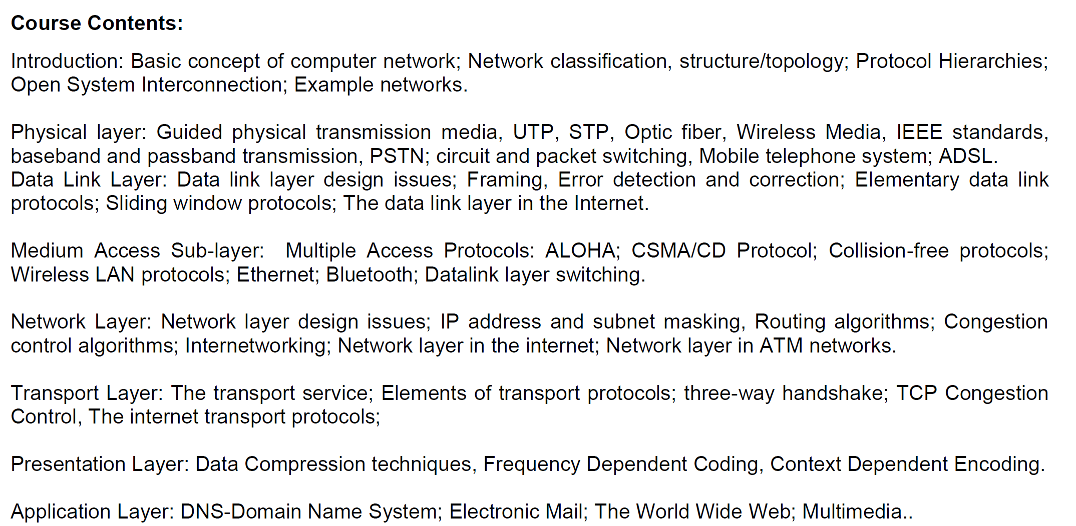

Slide 3
Routing
The main function of the network layer is routing packets from the source machine to the destination machine.
In most networks, packets will require multiple hops to make the journey.
The routing algorithm is that part of the network layer software responsible for deciding which output line an incoming packet should be transmitted on.

Slide 4
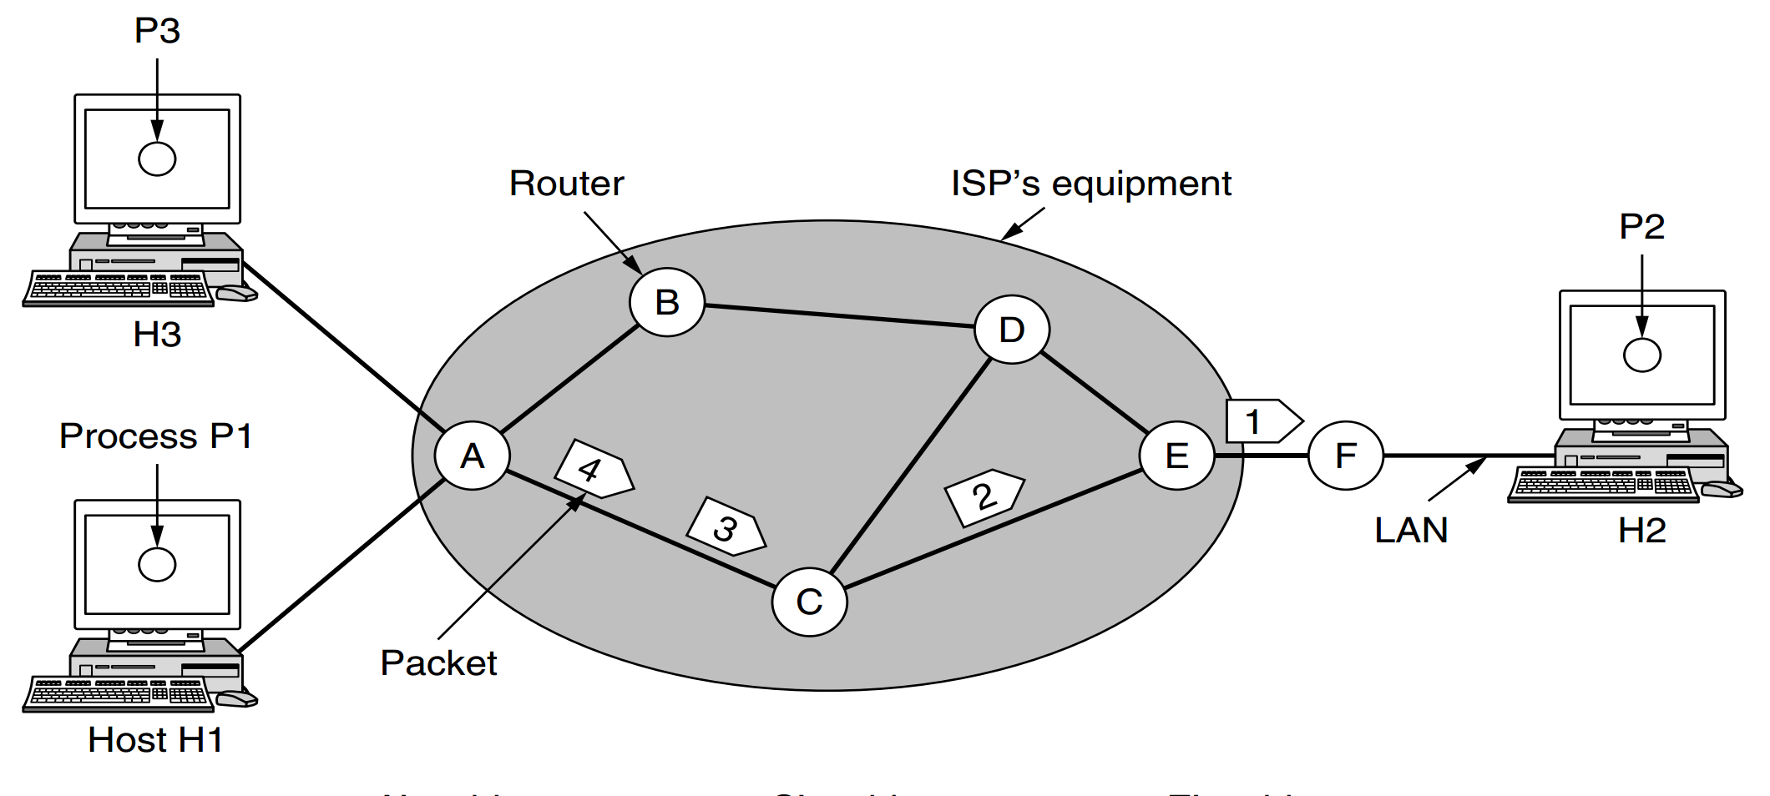
Routing
100 Hosts
150 Hosts
100 Hosts

Slide 5
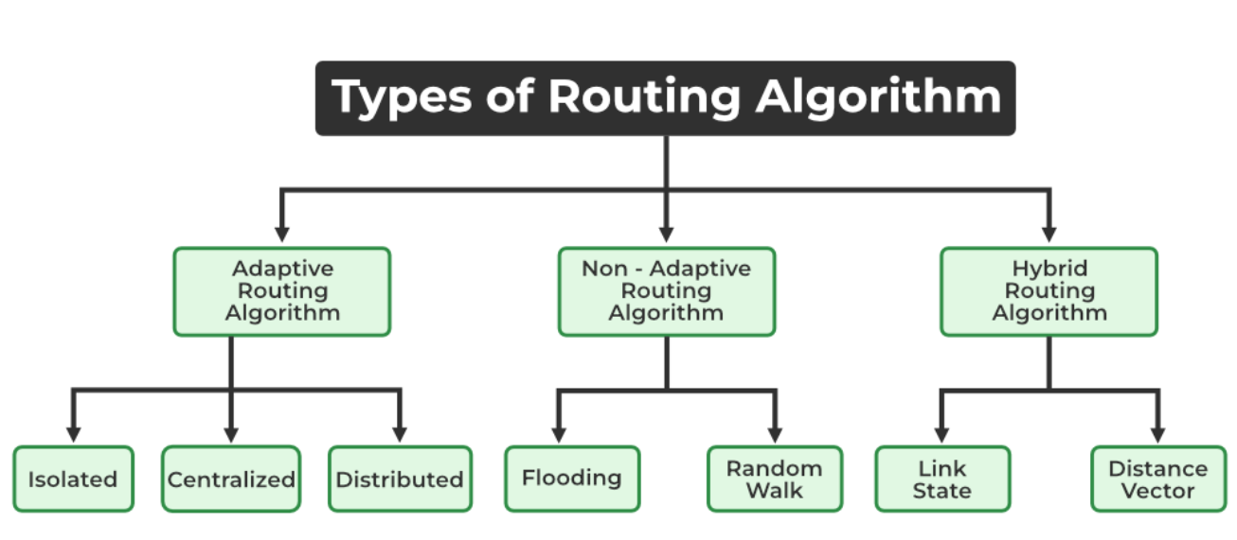
https://www.geeksforgeeks.org/classification-of-routing-algorithms/
Change their routing decisions whenever network topology or traffic load changes.
Also known as dynamic routing,
make use of dynamic information such as current topology, load, delay, etc. to select routes.
Optimization parameters are distance, number of hops, and estimated transit time.

Slide 6
Isolated: In this method each, node makes its routing decisions using the information it has without seeking information from other nodes.
Centralized: In this method, a centralized node has entire information about the network and makes all the routing decisions.
Distributed: In this method, the node receives information from its neighbors and then takes the decision about routing the packets.

Slide 7
These are the algorithms that do not change their routing decisions once they have been selected.
This is also known as static routing as a route to be taken is computed in advance and downloaded to routers when a router is booted.

Slide 8
Flooding
When a routing algorithm is implemented, each router must make decisions based on local knowledge, not the complete picture of the network.
A simple local technique is flooding, in which every incoming packet is sent out on every outgoing line except the one it arrived
D
S

Slide 9
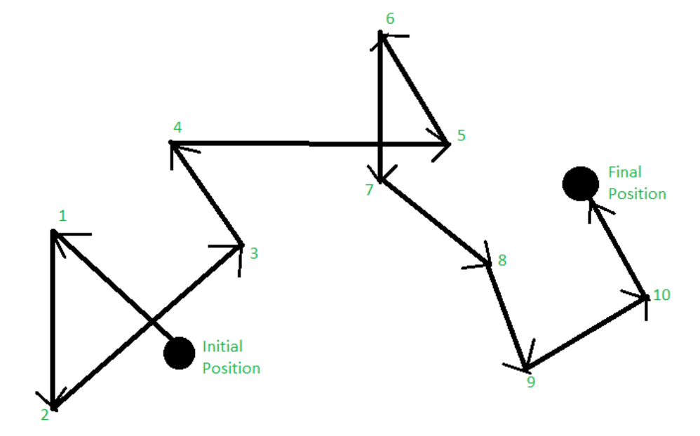
Random Walk

Slide 10
…these algorithms are a combination of both adaptive and non-adaptive algorithms.
In this approach, the network is divided into several regions, and each region uses a different algorithm.

Slide 11
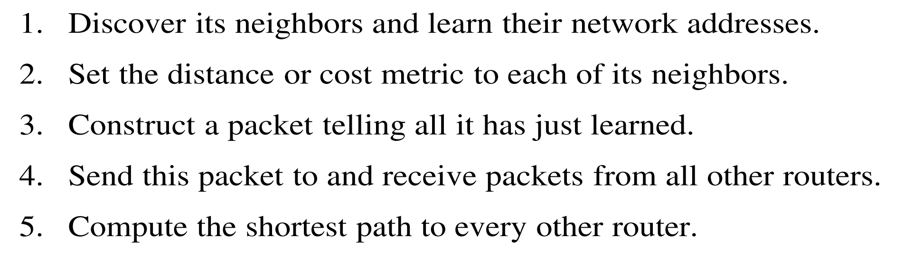
Link State Routing
Information sharing takes place only whenever there is a change.

Slide 12
Distance Vector Routing
A distance vector routing algorithm operates by having each router maintain a table (i.e., a vector) giving the best known distance to each destination and which link to use to get there.
These tables are updated by exchanging information with the neighbors. Eventually, every router knows the best link to reach each destination
As an example, assume that delay is used as a metric and that the router knows the delay to each of its neighbors

Slide 13
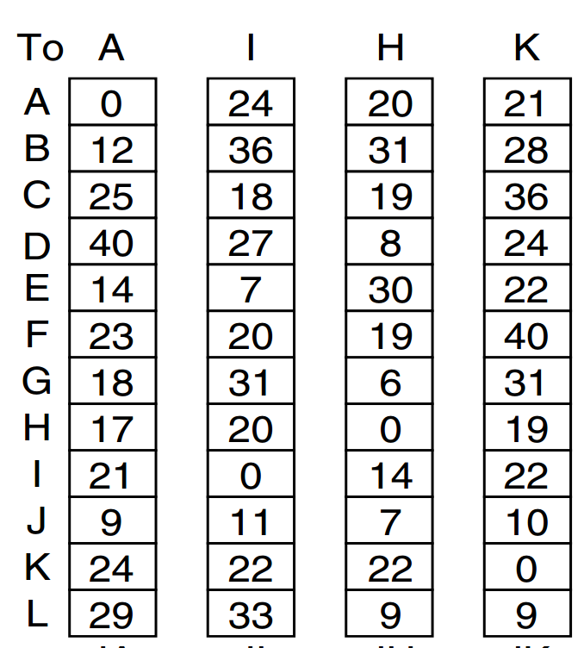
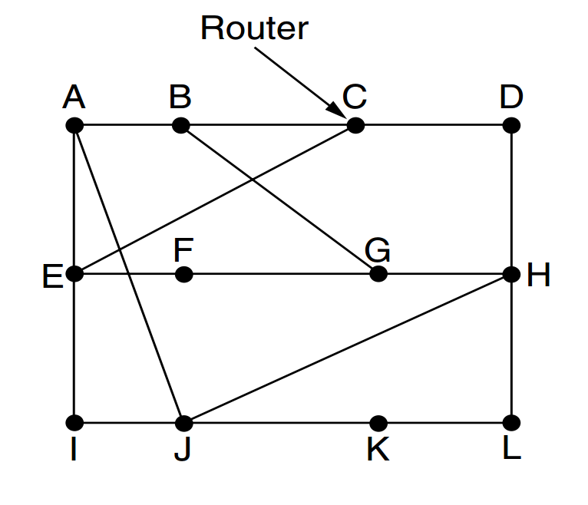
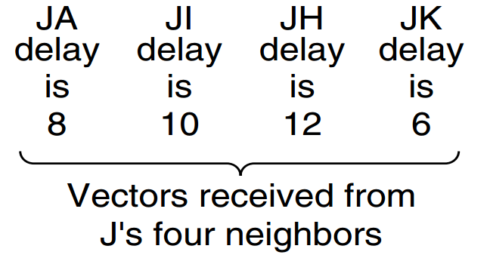




$$8+18=26$$
$$10+31=41$$
$$12+06=18$$
$$06+31=37$$
G: Send via A -18ms

Slide 14
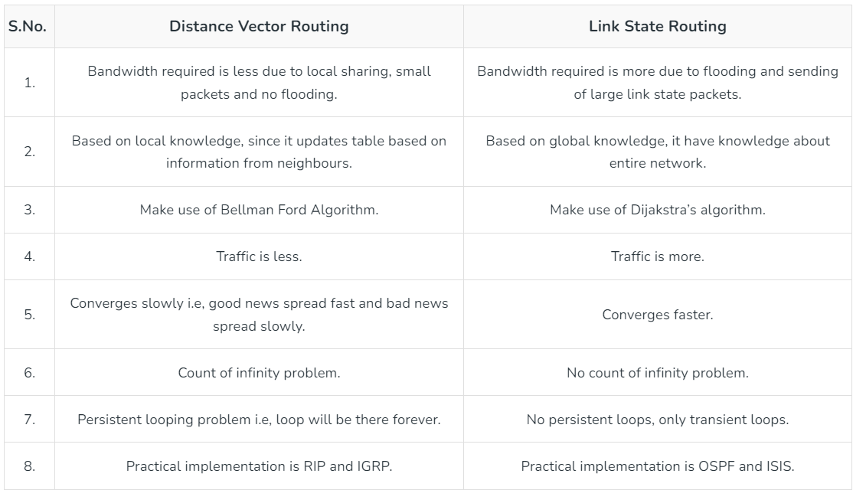
RIP - Routing Information Protocol
IGRP- Interior Gateway Routing Protocol
OSPF- Open Shortest Path First
ISIS-Intermediate System to Intermediate System

Slide 15
Optimality Principle
It states that if router J is on the optimal path from router I to router K then the optimal path from J to K also falls along the same route

Slide 16
ARP and RARP
Address Resolution Protocol (32bit IP to 48 bit MAC)
Reverse Address Resolution Protocol (48 bit MAC to 32 bit IP)

